Slide 1


ENHANCING EARLY BREAST CANCER DETECTION WITH K-NN ALGORITHM
Group 8:
Surya Aenuganti Ushasri
Aylin Kosar
Salma Omai
Nicolas Romero
Viraj Prasad Sapre

Slide 2

Agenda
Background
K-nn Algorithm
Data Analysis
Conclusion & Recommendations
References

Slide 3

BACKGROUND

Slide 4
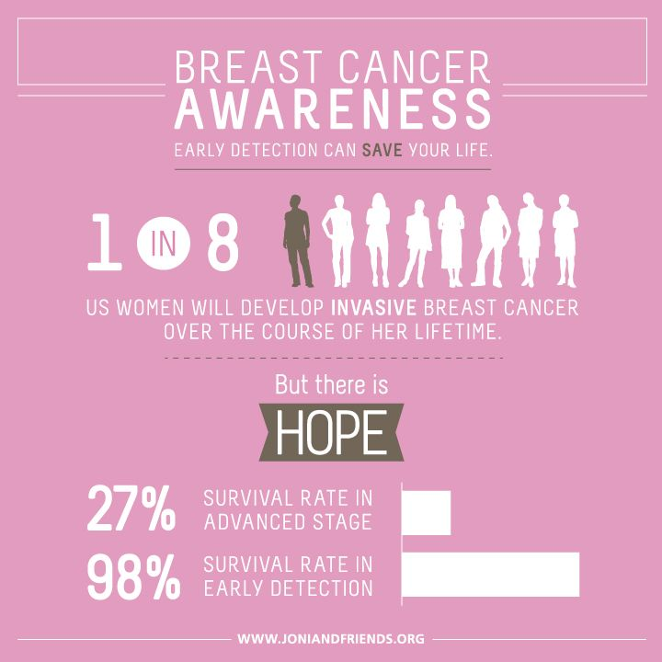
Facts About Breast Cancer
About 1 in 8 U.S. women is estimated to develop invasive breast cancer over her lifetime.
The most commonly diagnosed cancer among American women, besides lung cancer.
30% of newly diagnosed cancer in women will be breast cancer.
Breast cancer deaths are more common than other types of cancer, including lung cancer. [1]
Source: google.com.
Notes:
https://www.breastcancer.org/symptoms/understand_bc/statistics

Slide 5
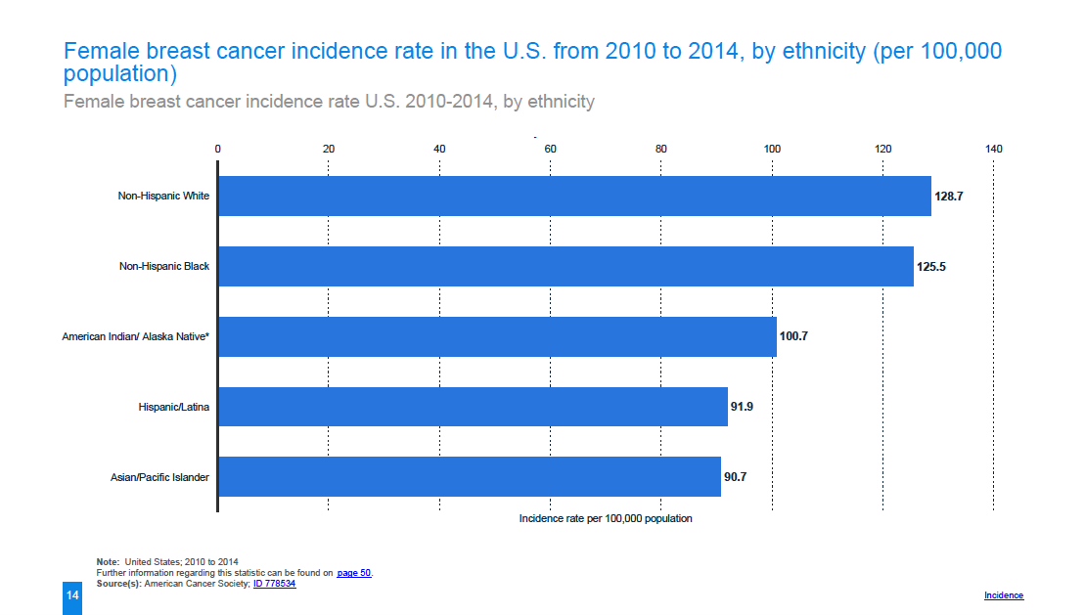
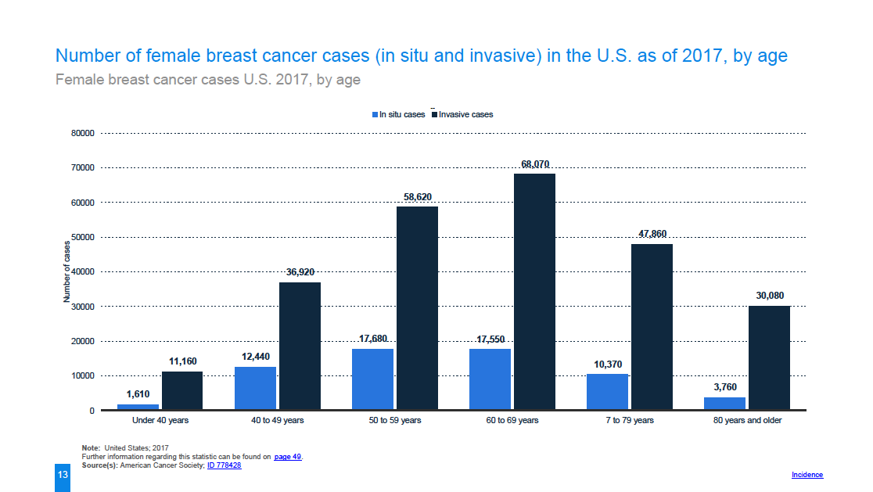
Facts About Breast Cancer
As of January 2018, more than 3.1 million of American women have a history of breast cancer.
Not just women are affect. Men too.
In 2018, 266,120 new cases of invasive breast cancer estimated to be diagnosed in American women and 2550 in American men.
Source: Statista - Breast Cancer in the U.S 2018 [3]
Notes:
https://www.breastcancer.org/symptoms/understand_bc/statistics

Slide 6
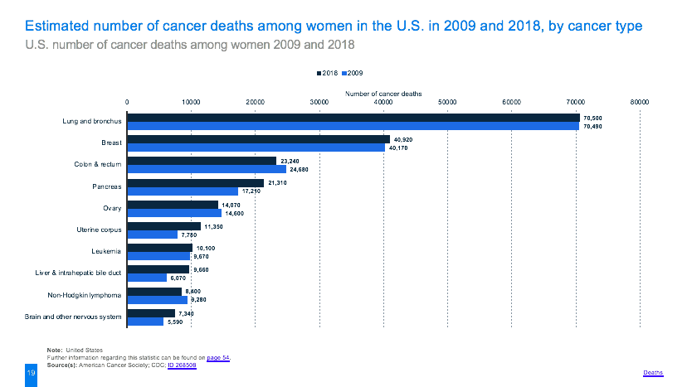
Road to Better Treatment with Data Mining Tools
The number of breast cancer deaths among American women has not decreased between 2009 and 2018 albeit researchers’ efforts.
Diagnosing breast cancer at an early stage is challenging because symptoms are not very obvious:
Information may contain uncertainty
Information may be insufficient
Information may be deceptive
Source: Statista - Breast Cancer in the U.S 2018 [3]
Notes:
Early diagnosis of breast cancer and timely medical treatment are important factors to prevent spreading to other tissues.
Saving time by reducing detection process and focusing on breast cancer treatment ahead of time.
Need of accurate methods to detect breast cancer - mammography has limitations to detect tumors (false negatives & positives)

Slide 7

Road to Better Treatment with Data Mining Tools
Tools such as Mammography, Magnetic Resonance Image (MRI), Ultrasound are used, but limitations exist in terms of accuracy and sensitivity.
Automate identification of cancerous cells with data mining tools to attain better diagnostic results:
Statistical Classifiers
Researchers at the Rutgers Cancer Institute of New Jersey are analyzing ways to employ data science in the early detection accuracy of breast cancer.
Source: healthcaregeek.

Slide 8
K-NEAREST NEIGHBOR ALGORITHM

Slide 9
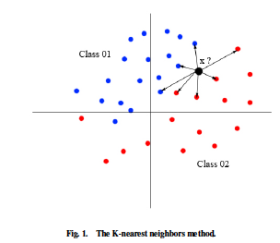
How Can It Help?
K-Nearest Neighbor (k-NN) Classification Algorithm is used to classify subjects based on distance between their neighboring subjects.
Classes used to classify data are known - supervised learning method
k-NN can be used to classify whether a certain cell is benign or malignant based on the distance to its neighboring cells.
“Quality of the results depends largely on the distance and the value of the parameter “k” which represent the number of the nearest neighbors.”
Source: Medjahed et al. 2013[2]
Notes:
Knn algorithm creates a prediction for a test case by using a distance measure to find and locate k “close” samples in the
training data for each test sample and uses those selected samples to make a prediction. In this context, it will be used for cancer detection because of its ease of implementation.

Slide 10
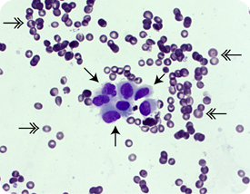
How Can It Help?
Cells within that sample are studied to see whether the tumor is benign or malignant. These are classified into either the Benign or Malignant Class based on key attributes.
Performance will be evaluated in terms of the classification accuracy rate and classification time using different K parameters and classification rules.
Training Set - Applying k-NN Algorithm to build model
Testing Set - Validating accuracy of model
Source: google

Slide 11
DATA ANALYSIS

Slide 12
A Glance At The Dataset & Data Exploration Steps
Data source:
Wisconsin Breast Cancer Diagnostic from UCI Machine Learning Repository
Dr. William H. Wolberg, W. Nick Street, Olvi L. Mangasarian on November 1995
Data exploration steps:
1- Organizing the data set
2- Creating training and test (validation) datasets
3- Executing knn
4- Testing different values of k
5- Ways to improve data analysis

Slide 13
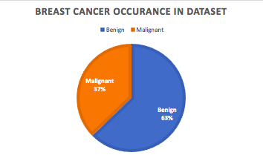
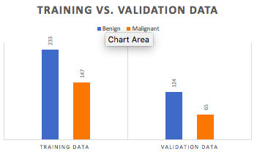
Data Explorations Steps
1- Organizing the data set
Size: 569
Benign: 357; Malignant: 212
Attributes: Radius, Texture, Perimeter, Area, Smoothness, Compactness, Concavity, Concavity Points, Symmetry.
No missing data
Normalized variables
Removed class labels and tag them with patient ids.
2- Creating training and test (validation) datasets
Randomly split
⅔ training data ⅓ validation
Training: Benign 233, Malignant 147
Validation: Benign 124,Malignant 65
Notes:
FNA is a popular diagnosis techniqye

Slide 14
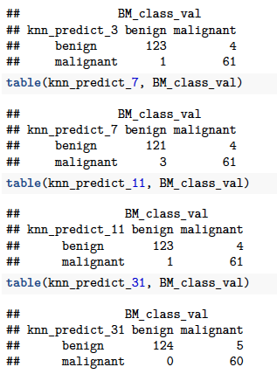
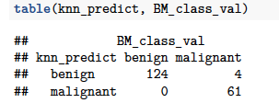
Executing K-nn & Testing Different Values of K
Different values of k: 3, 7, 11 and 31
Set value of K to 3
This was done to explore which K values gives the highest accuracy in predicting breast cancer cells.

Slide 15
RECOMMENDATIONS & CONCLUSION

Slide 16
Recommendations on How to Improve Data Analysis
Chose the most significant variables.
30 variables are a lot to consider and may negatively impact the variance.
Determine significance based on the F-statistic.
Assessing variables with best fit using Monte Carlo cross-validation.
Having only one training set and one validation set
Inability to check
We can also improve the processing time taken for the Knn by using parallelization of the cores

Slide 17
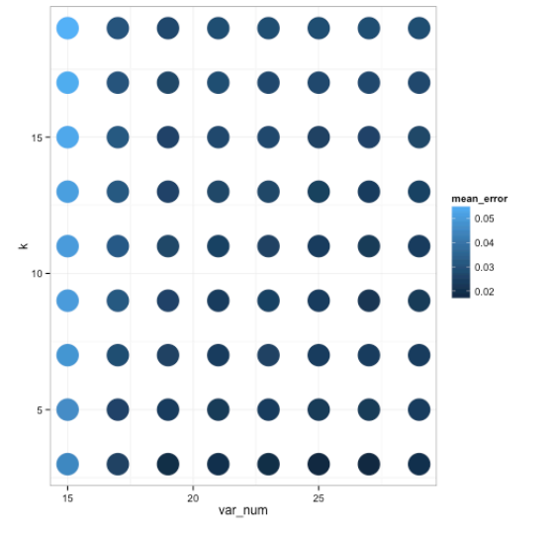
Conclusion
K-nn allows to predict whether a cell is malignant or benign based on the classification of its nearest neighboring cell and using a K- value.
In this analysis, we concluded that k-value of 3 and using only 19 variables yield the most accurate predictions.

Slide 18
REFERENCES

Slide 19
[1] BreastCancer.org. (2018 October 16). U.S. Breast Cancer Statistics. https://www.breastcancer.org/symptoms/understand_bc/statistics
[2] Seyyid Ahmed Medjahed, Tamazouzt Ait Saadi and Abdelkader Benyettou. Article: Breast Cancer Diagnosis by using k-Nearest Neighbor with Different Distances and Classification Rules. International Journal of Computer Applications 62(1):1-5, January 2013.
[3] Statista. [2018]. Breast Cancer in the U.S. pg 7-75
https://www-statista-com.proxy.libraries.rutgers.edu/study/49557/breast-cancer-in-the-us/

Slide 20
THANK YOU

